Slide 1
E-Commerce Data Analysis
Managing Info & Tech and Systems – 5570
Group Members: Vinay Govindan
Caner Irfanoglu
Mohd Nawaz Hussain
Sunil M Padikar
Gaganpreet Singh

Slide 2
Description of Data – I
OS_ORDER
ORDER_ID: Unique order id
ORDER_CODE: 12 digit unique order code
BUYER_ID: 5 digit unique number assigned to buyer
PAY_DT: ‘yyyy-mm-dd HH:MM:SS’ formatted date for time of transaction
CREATE_IP: IP Address where the order is placed from
ORDER_STATUS: Status information takes values between 1-9, A, B, z

Slide 3
Description of Data – II
OS_ORDER_ITEM
ITEM_ID: Unique index number for the purchased item
ORDER_ID: Unique order id
GOODS_ID: 7 digit unique item id of the purchased item
GOODS_NUMBER: Quantity of the purchased item
SHOP_PRICE: Retail price of the item
GOODS_PRICE: Wholesale price of the item for the company
7. GOODS_AMOUNT: Revenue generated from the transaction

Slide 4
Technologies Used – I
HDFS
Data transferred from SMU dev server to Hadoop distributed file system
Used to store the dataset
df_order = spark.read.option("delimiter", "\\t").option("header", "true").csv("/user/root/OS_ORDER.txt")
df_item = spark.read.option("delimiter", "\\t").option("header", "true").csv("/user/root/OS_ORDER_ITEMS.txt")

Slide 5
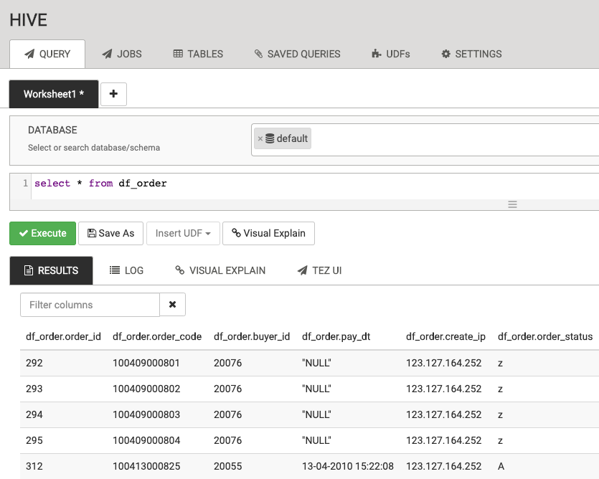
Technologies Used – II
Imported datasets from PySpark dataframe to Apache Hive
Queried the tables for initial overview
Apache Hive

Slide 6
Technologies Used – III
Connected to Tableau through Apache Hadoop Hive using the ODBC
Tableau

Slide 7
Technologies Used – IV
Used for data cleaning and data preparation
Apache PySpark
Steps Taken:
Data has been exported from HDFS to pySpark dataframe
Data has been imported to Apache Hive for querying
Extra columns have been dropped and rows containing ‘NULL’ values are removed
Datafames are joined based on ‘ORDER_ID’
Feature Engineering is performed using pySpark

Slide 8
Technologies Used – V
Apache MLlib
Used to perform Unsupervised Machine Learning
K-Means Algorithm is used for grouping customers
assembler=VectorAssembler(inputCols=["PROFIT","RECENCY","ORDER_COUNT"], outputCol="features")

Slide 9
Exploratory Analysis – I

Slide 10
Exploratory Analysis – II
Exploratory Analysis – II

Slide 11
Exploratory Analysis – III

Slide 12
Exploratory Analysis – IV

Slide 13
Exploratory Analysis – V

Slide 14
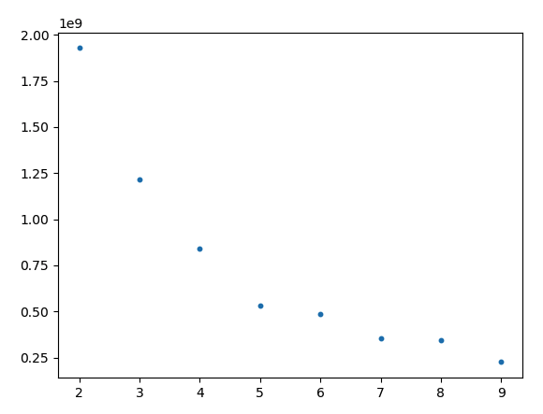
Results – I
Elbow Plot

Slide 15
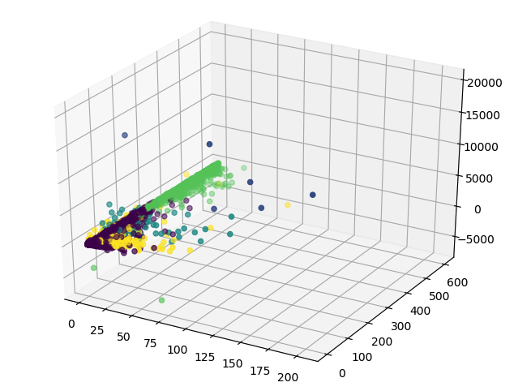
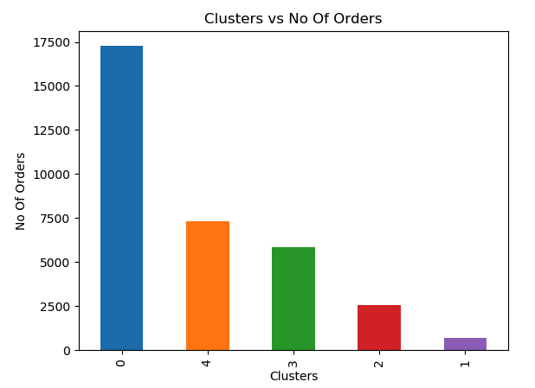
Results – II
3-D Buyer Cluster Visualization
Total Orders Across Clusters

Slide 16
Conclusion
Analysis done on orders and buyer’s behaviour separately
3.2% of orders placed by top 10 buyers
Total number of orders over months increasing
‘Recency’, ‘Frequency’ and ‘Monetary’ (profit) data is extracted for customer segmentation
5 separate clusters represent different groups of customers
Project allowed the group to make use of multiple technologies provided by Apache

Slide 17
Additional Feedback
Difficulties Faced
Difficult to write map-reduce code for simple tasks
Simple data transformation and ingestion tasks required significant effort from time to time
The execution time was too long for Apache Hive
Easily understandable topics
Understanding working with the tools designed to provide conventional work flows was relatively easy
Hive uses similar syntax to conventional SQL structure
Zeppelin uses the modern notebook style development interface, versatile and easy to follow

Slide 18
Thank You!

